Slide 1
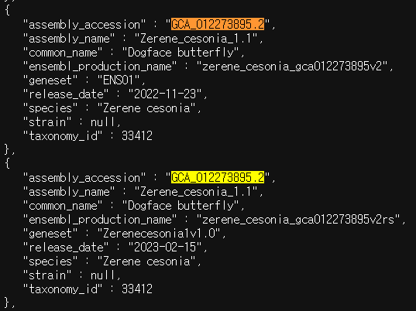
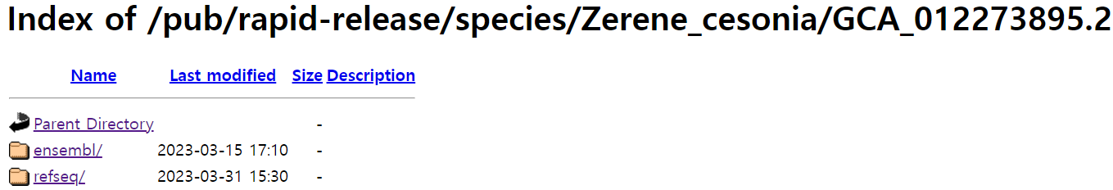
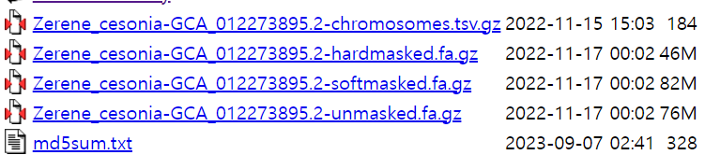
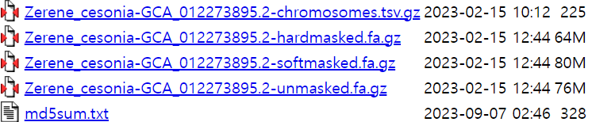
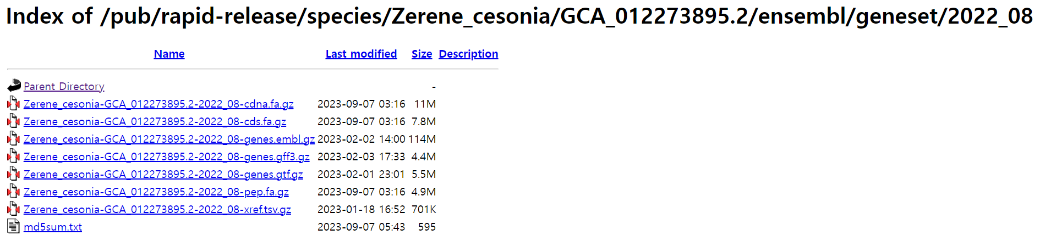
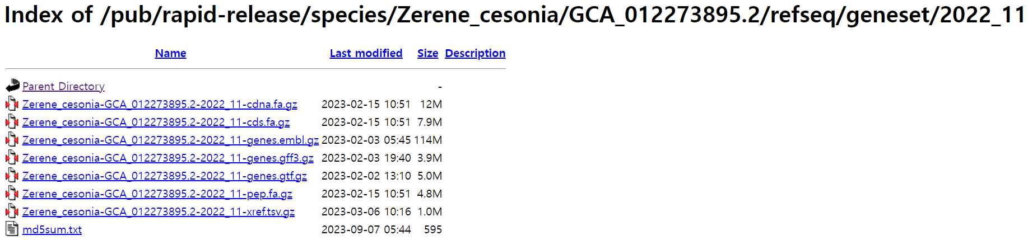
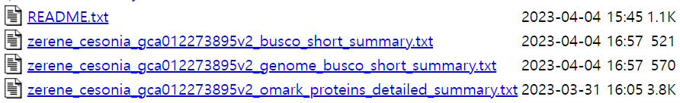

Slide 2
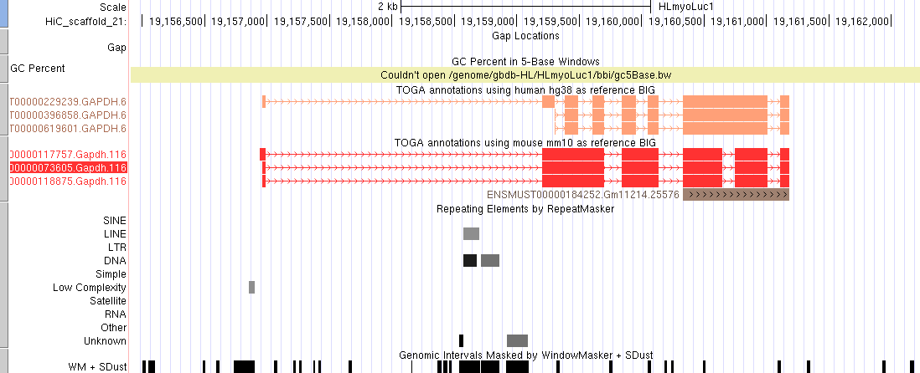
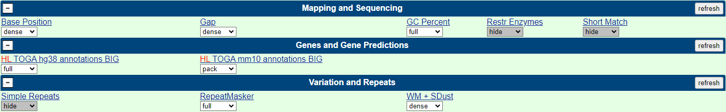

Slide 3
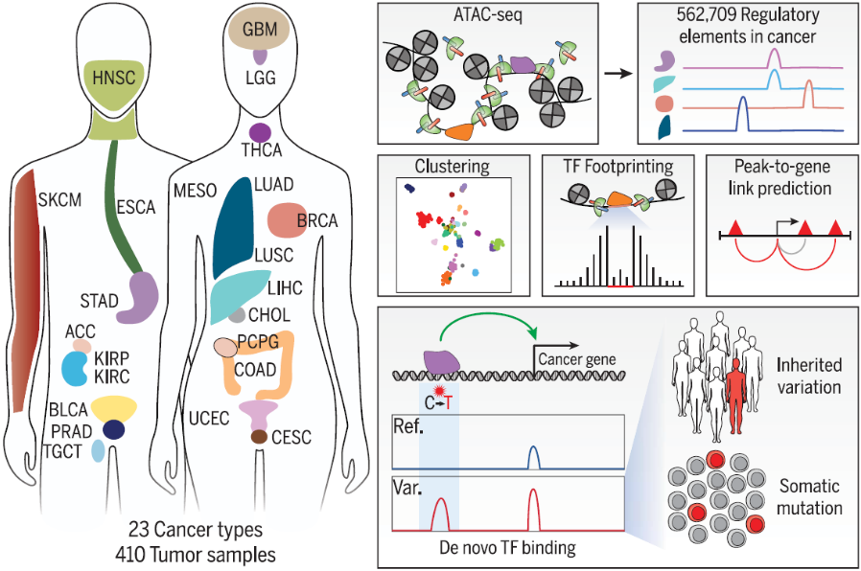
Samples
Remove the bottom 25%
of genes and peaks
based on variance
(= standard deviation / mean)
ATAC-seq,
ChIP-seq, etc
Signal density
values
Peak set
Location
Samples
Construct gene-peak networks
within a 0.5Mb range
Create conservative null model
using 10,000 random peaks
from other chr and > 0.5Mbp
RNA-seq
Gene / Transcript
RNA
Expression
values
Calculate correlations
between genes and peaks
Calculate mean and std
of the correlation values
TSS location
Output format
Gene annotation
(Ensembl.gtf)
chr, start,
end, strand
Calculate
the p-value and FDR
Peaks set
correlation
Gene / Transcript
Gene / Transcript
P-value
FDR

Slide 4
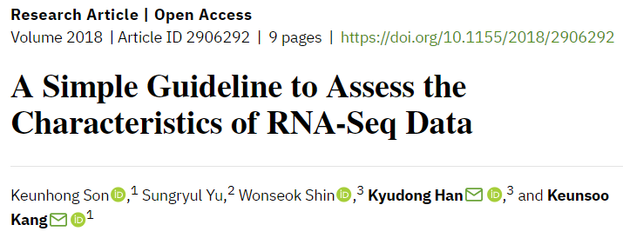


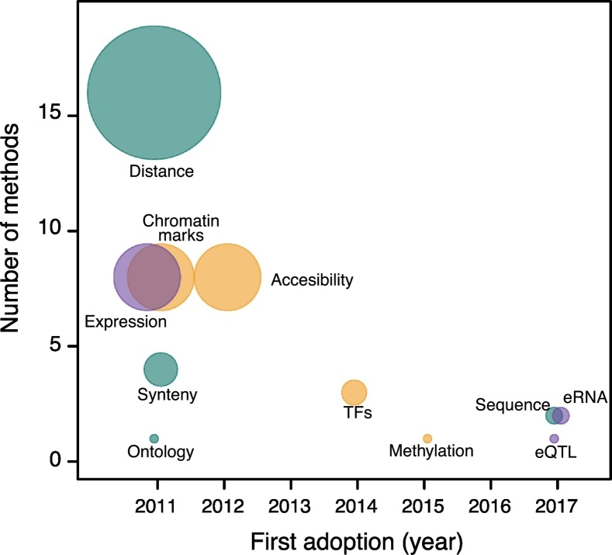
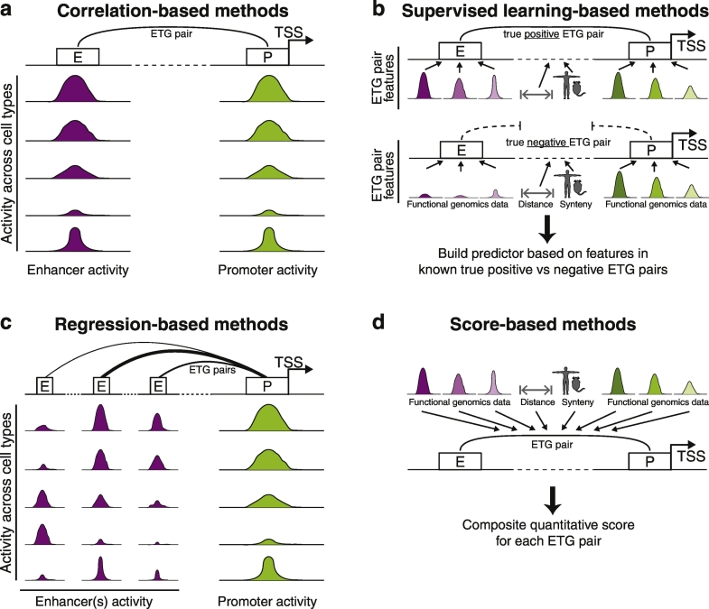
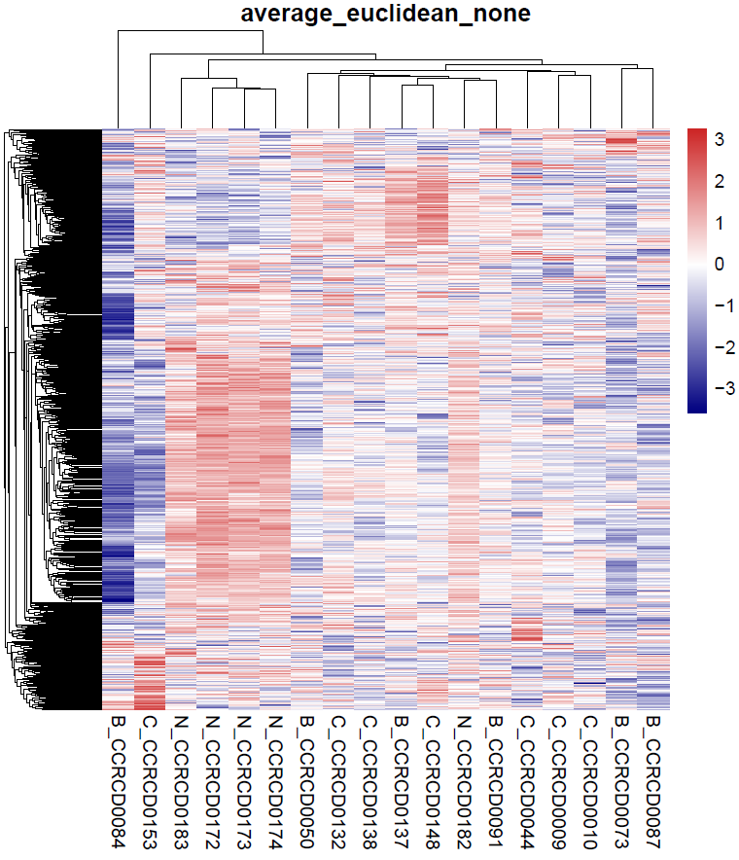
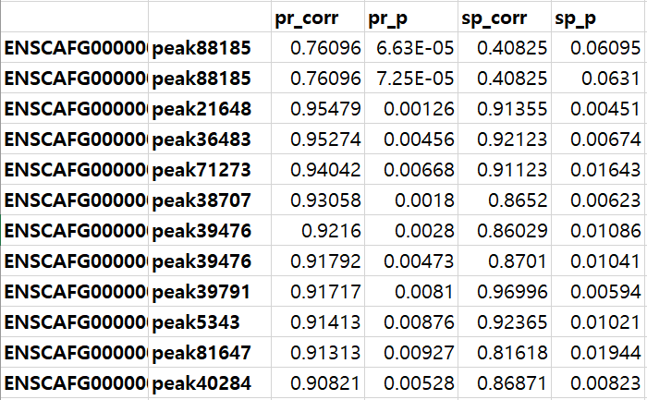
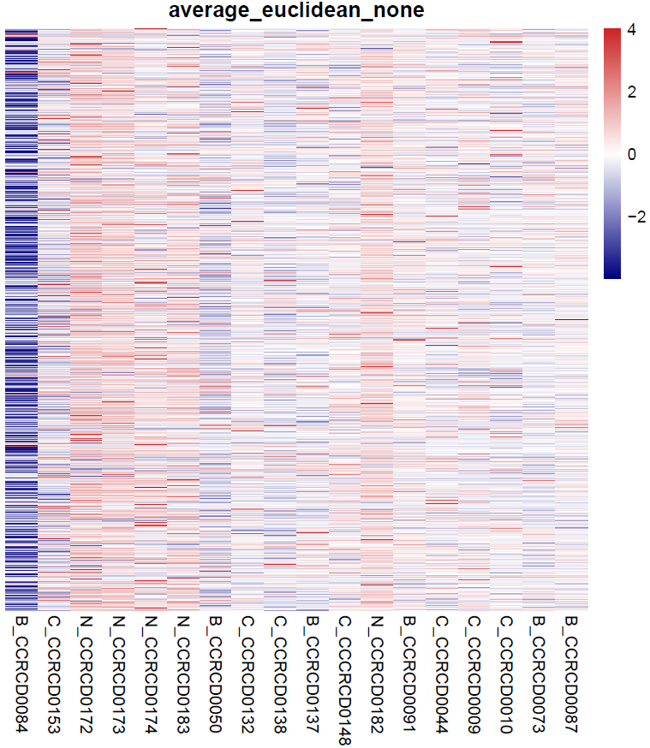
Gene-linking
Bio Med Research International
(IF = 2.5)
Annotaion관련 IF 2 – 4 점대 논문 가능??
ATAC-RNA / ChIP-RNA / Methly-RNA/ eATAC-pATAC
Published: 2019.06 (IF = 4.7)
Pearson, p < 0.05: 5303
positive: 3553
negative: 1750
pearson
spearman
ATAC-seq
RNA-seq

Slide 5

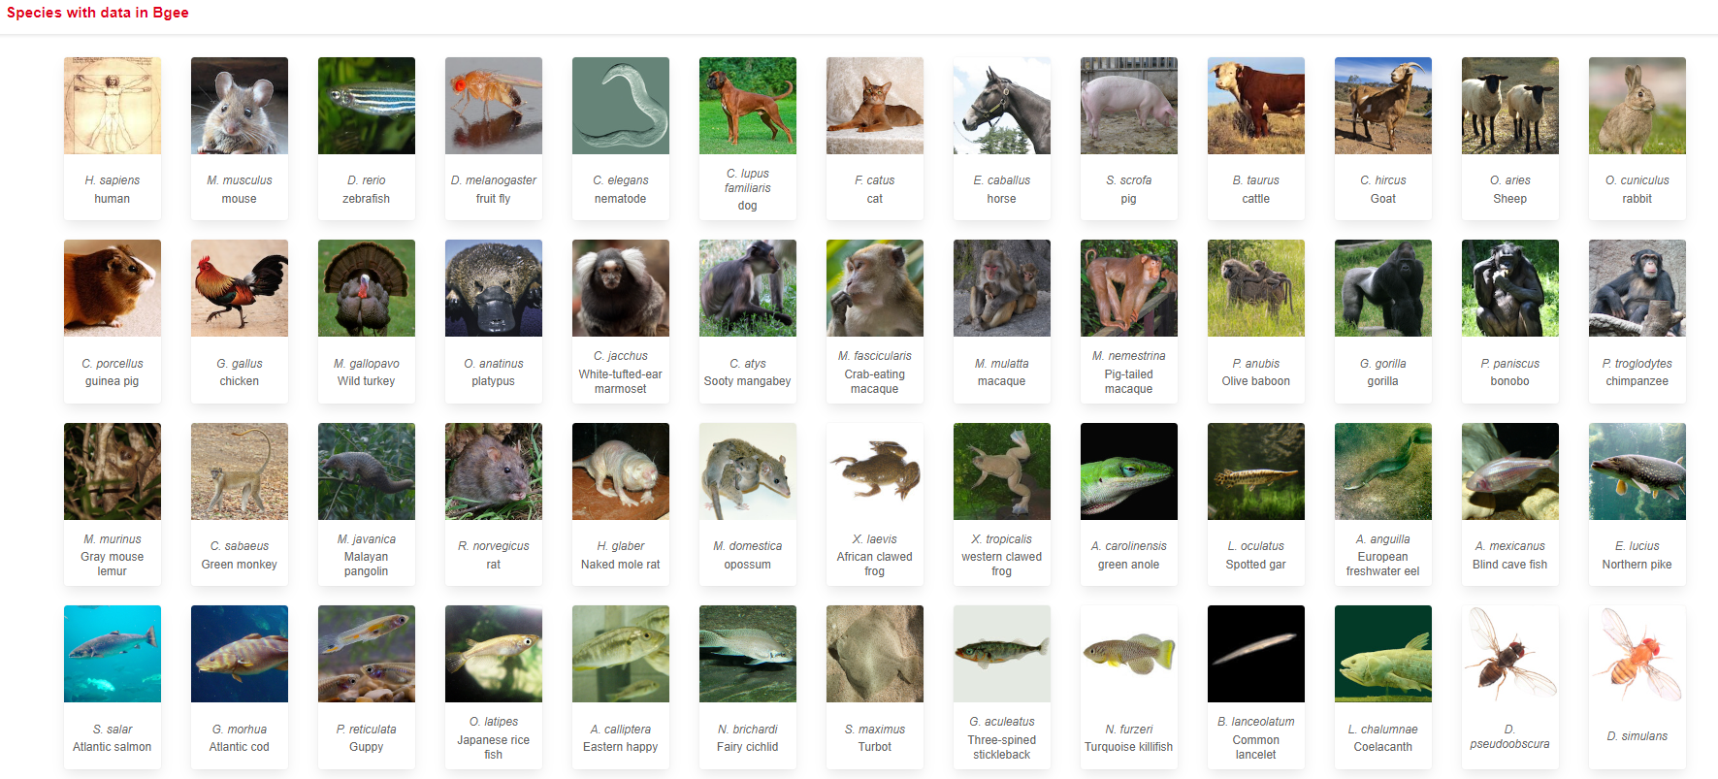
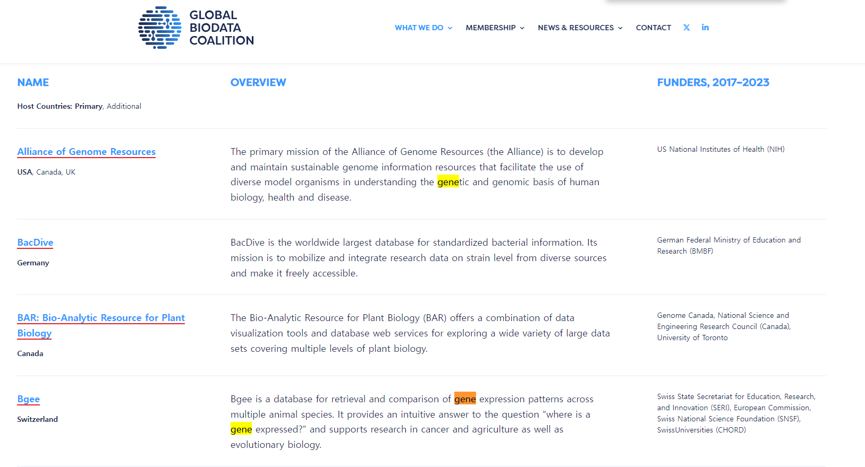

Slide 6
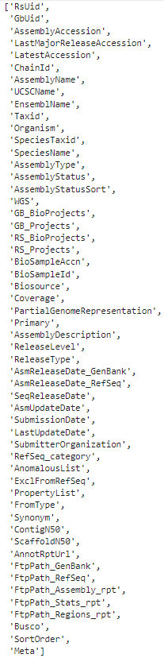
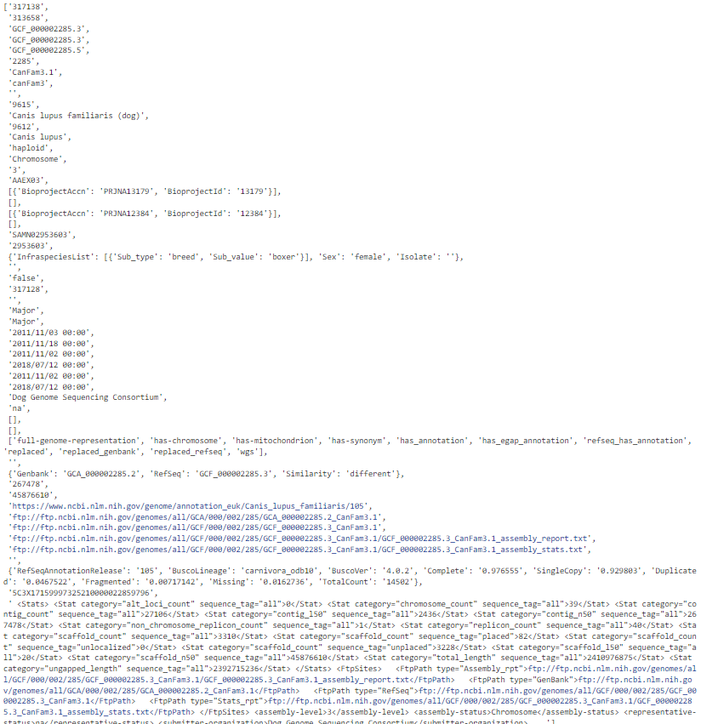

Slide 7












Red: Reference genome
Blue: Gene annotation
GenBank
RefSeq
Researchers
submit new
genomes
High-quality genomes
are selected
GCF ids are issued.
(ex. GCF_000002285.5)
GCA ids are issued.
(ex. GCA_000002285.4)
RefSeq gene annotations
are produced.
N* ids (ex. NM_001357943.2)
GenBank & RefSeq
genomes are stored.
GenBank genomes
are stored.
RefSeq gene annotations
are stored.
Ensembl gene annotations
are produced independently.
ENS* ids (ex. ENSG00000111640.15)
[Other databases]
Human & Mouse
GENCODE gene annotations
are produced by integrating
ENSEMBL & HAVANA.
ENS* ids (ex. ENSG00000111640.15)

Slide 8
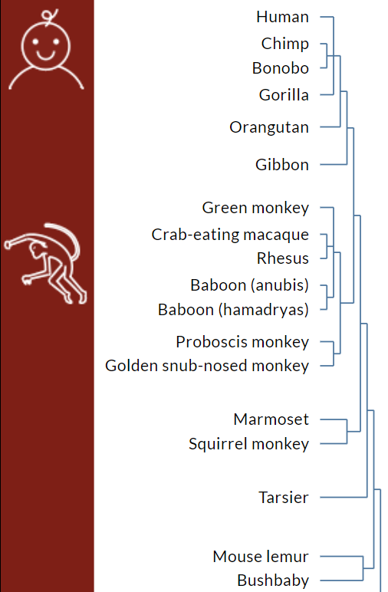
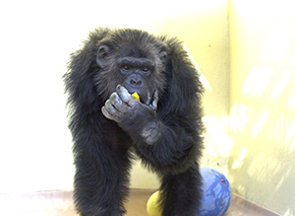
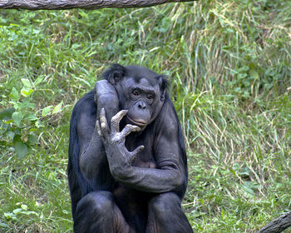
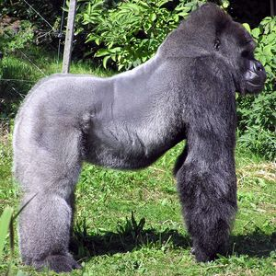

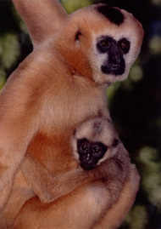
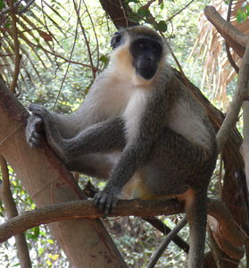

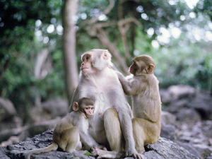
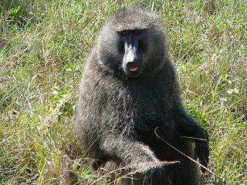
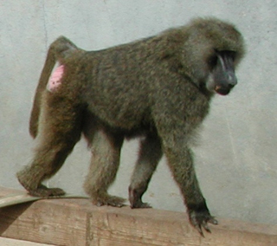



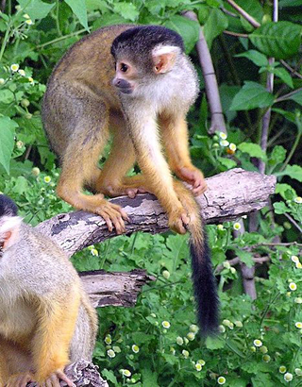

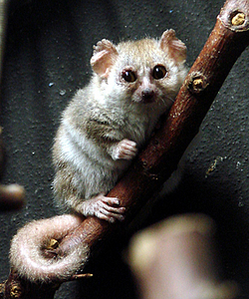
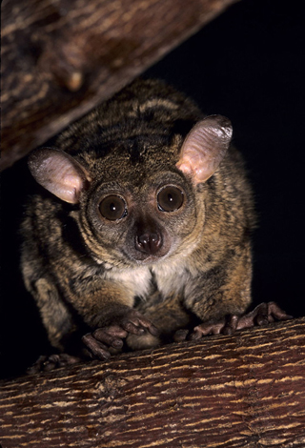


Slide 9
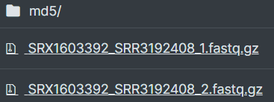
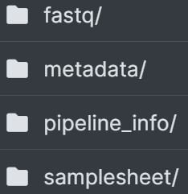
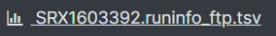
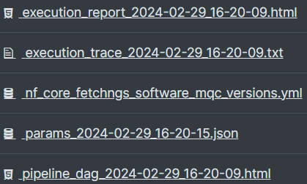
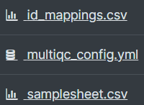

Slide 10
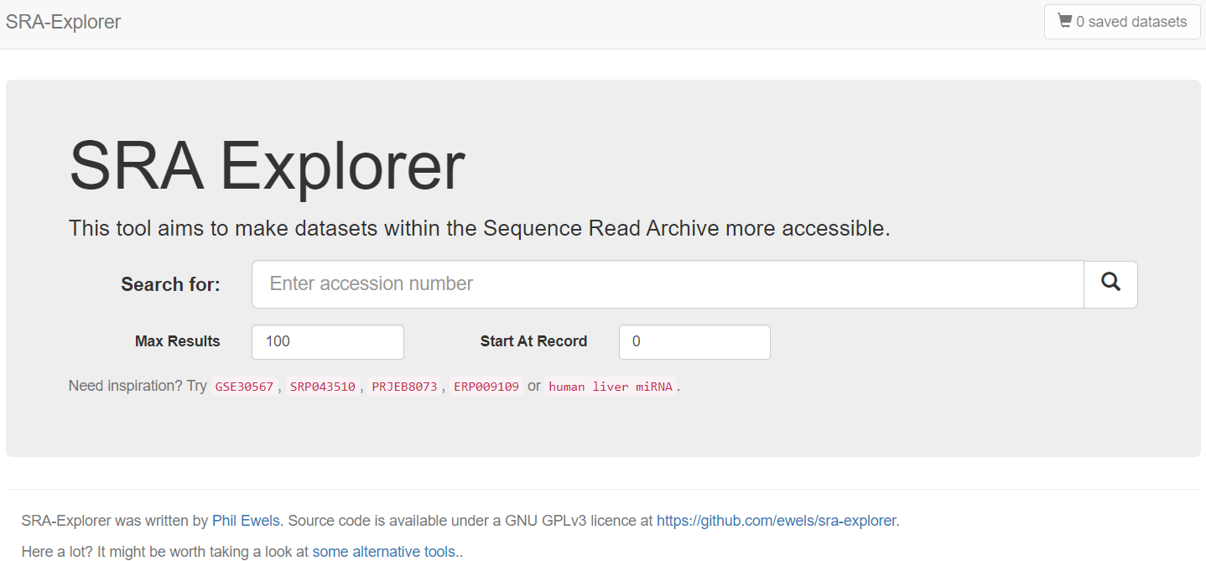
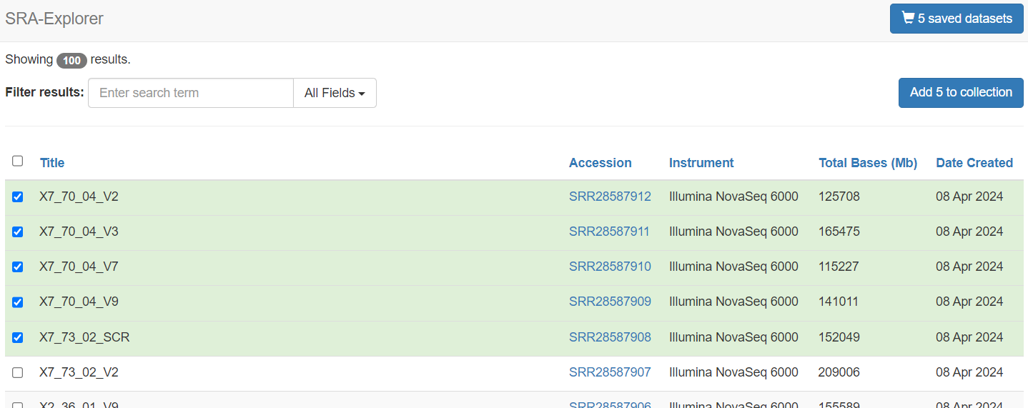
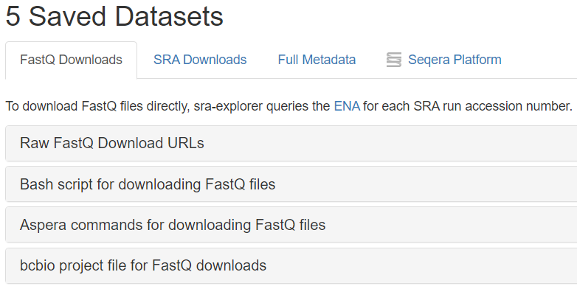
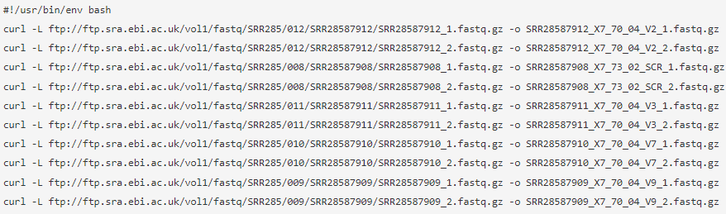
1. Enter “accession number” or
“the keywords as if you are searching in the SRA database”
The results when searching for "Homo sapiens"[Organism] AND RNA-Seq[Strategy].
3. Click “Add to collection”
& move to “saved datasets”
2. Select relevant datasets
4. You can get ftp or aspera download links

Slide 11
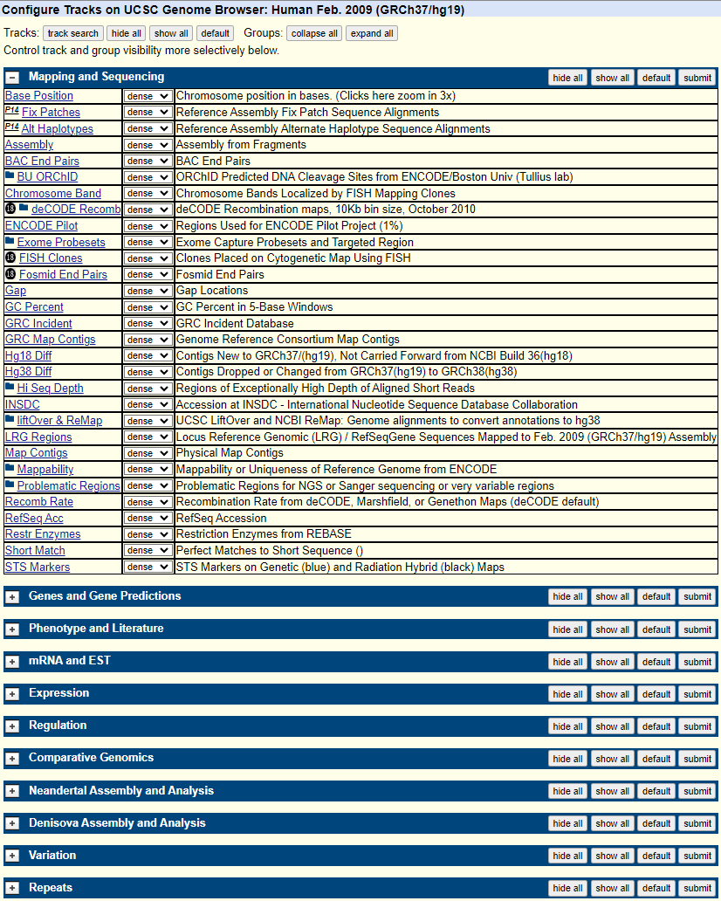
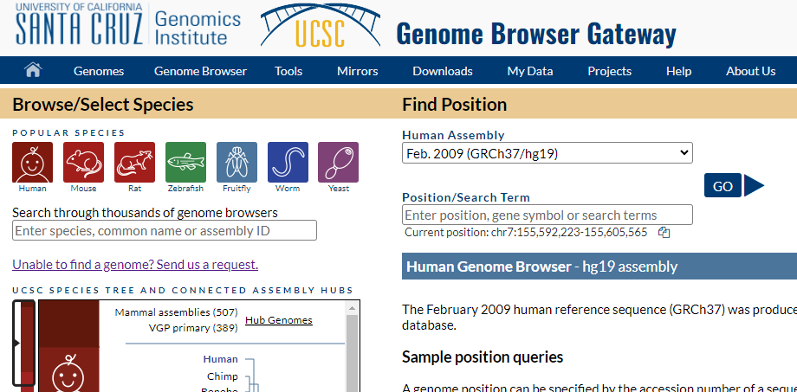
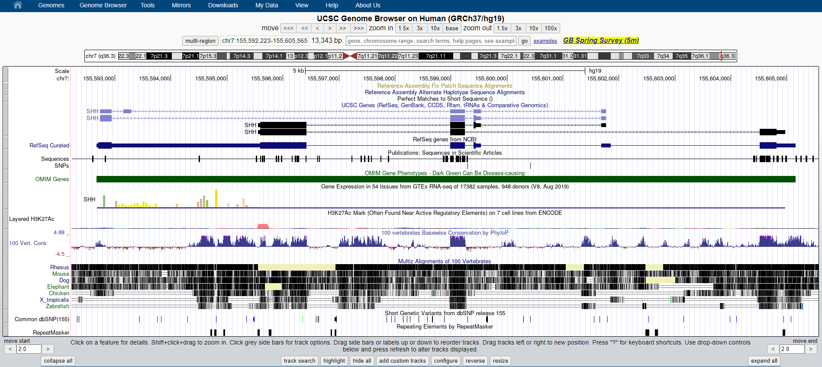
1. Click the “Genomes” button
2. Select the species & genome assembly
3. Click
3. Click the “configure” button

Slide 12
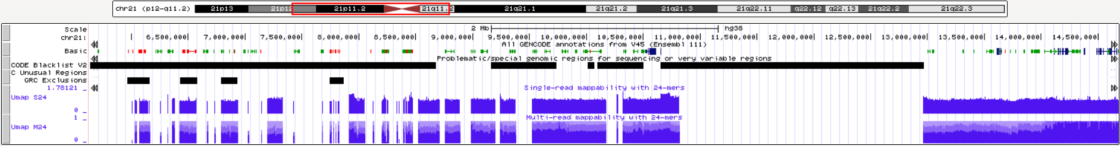
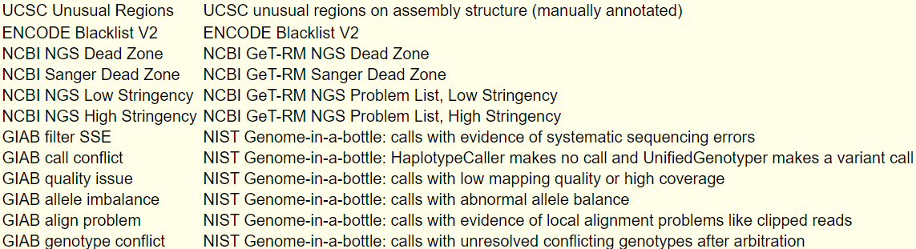
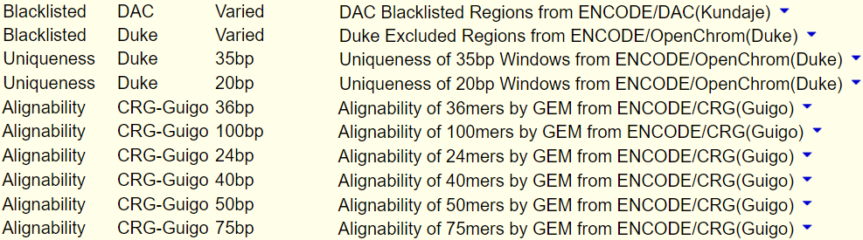
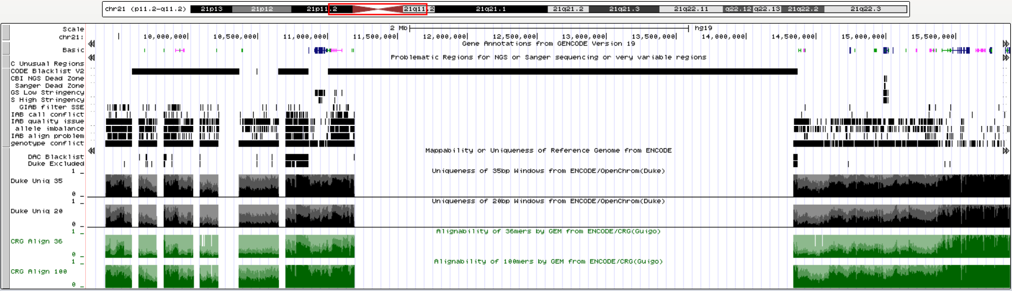
GRCh 38 (hg38)
Problematic Regions
Mappability
GRCh 37 (hg19)
Problematic Regions
Mappability

